Slide 1
Random Graphs
13 March

Slide 2
Revision: Clustering
Local clustering coefficient = no. of edges / possible no. of edges of neighbors
Average clustering coefficient = mean of local clustering coefficients
Transitivity = no. of closed triads / no. of paths of length 2
= 3 * no. of triangles / no. of triads

Slide 3
Transitivity
Transitivity = no. of closed triads / no. of paths of length 2
= (6 * no. of triangles) / (2 * no. of triads)
= (6 * 1) / (2 * 6)
= 1/2
5
1
4
2
3
Notes:
Draw a triangle, illustrate the 3 closed triplets.
Show the concept of open and closed triangle, and paths of length 2
Then give an example using a simple graph of 5 nodes with a triangle.

Slide 4

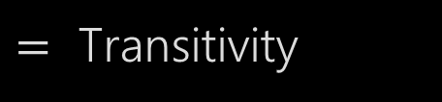
Transitivity
1. No. of triads, $t_{g}= \sum{t_{i}}=\sum{(\begin{aligned}k_{i} \\ 2\end{aligned}})=\sum{\frac{k_{i}\left(k_{i} −1\right)}{2}}$
2. No. of triangles, $δ_{g}=\frac{1}{3}\sum{δ_{i}}$
3. Local CC, $C_{i}=\frac{δ_{i}}{t_{i}}$
4. Average CC, $C_{g}=\sum{C_{i}\frac{1}{n}}$
5. Weighted CC, $C_{w}=\sum{C_{i}\frac{t_{i}}{\sum{t_{i}}}}=\sum{\frac{C_{i}⋅t_{i}}{\sum{t_{i}}}}$
$=\sum{\frac{δ_{i}}{t_{g}}}$
$=\frac{3δ_{g}}{t_{g}}$
1
$=$ Transitivity
Notes:
If want to calculate triplets for a node, neighbouring connections are irrelevant, since center is the node. So just pick any two neighbours, so it is k choose 2.

Slide 5
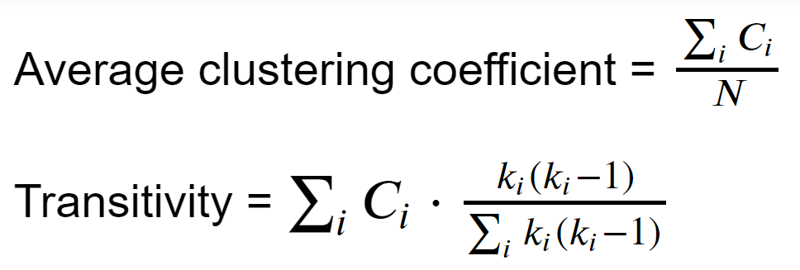
Transitivity vs Clustering Coefficient
Both are measures that attempt to quantify the same thing - probability of a friend knowing another friend if you know both of them
Transitivity = weighted average of local clustering coefficients by k choose 2
If transitivity is higher than average clustering coefficient, local clustering values are higher for nodes with high degrees, and vice versa

Slide 6
Revision: Erdos-Renyi
Erdos-Renyi model:
N = no. of nodes, p = probability of an edge existing between two nodes
N = 4, p = 0.5
Notes:
Has pretty much none of the properties that social networks display

Slide 7
Revision: Watts-Strogatz
Watts-Strogatz model:
N = no. of nodes, k = average degree, beta = probability of rewiring
N = 6, k = 2, beta = 0.2
Notes:
High clustering coefficient, but degree distribution is not scale free

Slide 8
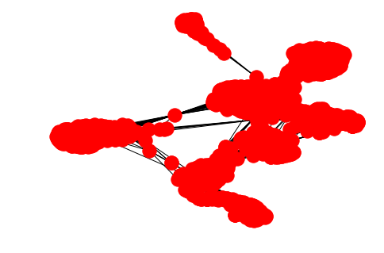
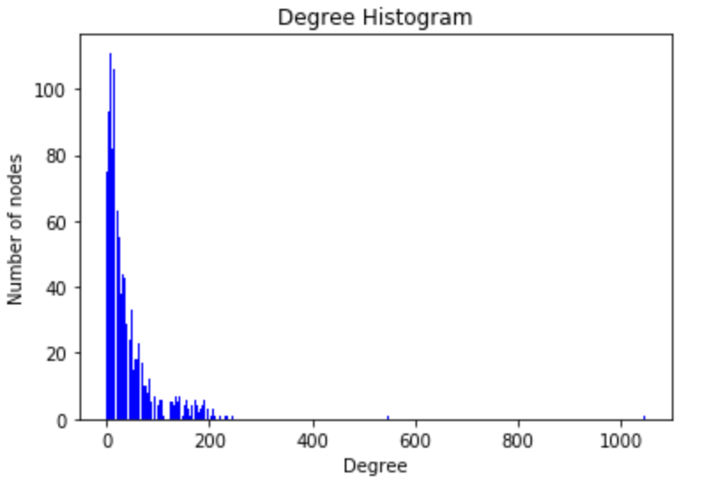
Revision: Facebook
High clustering coefficient (0.6) and transitivity (0.5)
Scale free degree distribution
Noticeable clusters

Slide 9
Stochastic Block Modelling
A method to generate random graphs by predetermining clusters, then adding edges within and between clusters
N = no. of nodes
p1 = probability of edge existing between two nodes from the same cluster
p2 = probability of edge existing between two nodes from different clusters
χ = expected no. of clusters
Typically, p1 > p2

Slide 10
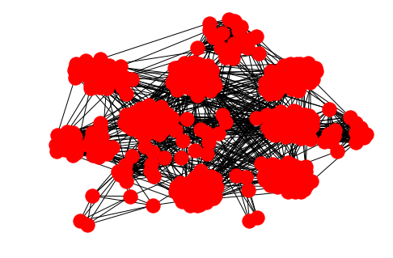
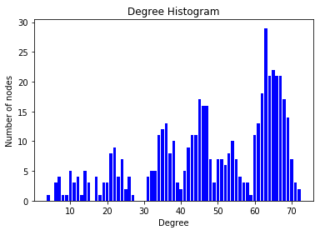
Implementation
Looks a bit like Facebook
Clustering can be adjusted by varying p1 and p2
Degree distribution, however, is very different
So let’s add preferential attachment
(Where nodes are added with probability increasing with the degree of a node)
N = 500, p₁ = 0.4, p₂ = 0.02, χ = 15

Slide 11
Chang-Chang Model
Predetermine clusters, then scatter nodes on a plane, with clusters scattered close together
Edges are added with preferential attachment, and dependent on Euclidean distance between nodes on the plane
n = no. of nodes
k = average degree
φ = weight of node degree
χ = no. of clusters
δ = extent of closeness in scatter of nodes around cluster ‘base’

Slide 12
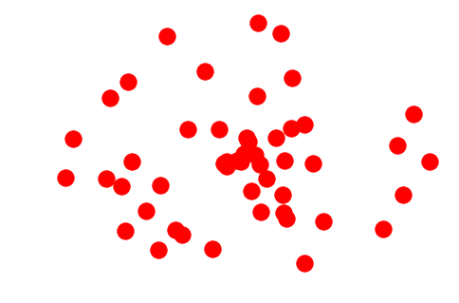
Chang-Chang Model
Add χ nodes as cluster ‘bases’ , with randomly generated polar coordinates
2. Split n-χ remaining nodes into the χ clusters

Slide 13
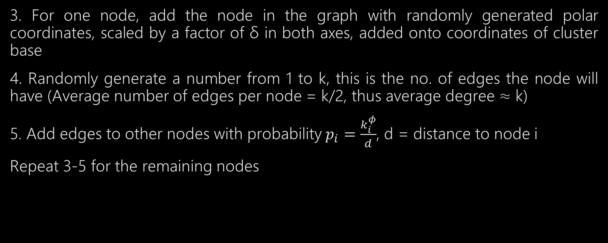
Chang-Chang Model
3. For one node, add the node in the graph with randomly generated polar coordinates, scaled by a factor of δ in both axes, added onto coordinates of cluster base
4. Randomly generate a number from 1 to k, this is the no. of edges the node will have (Average number of edges per node = k/2, thus average degree ≈ k)
5. Add edges to other nodes with probability$p_{i}=\frac{k_{i}^{φ}}{d}$, d = distance to node i
Repeat 3-5 for the remaining nodes

Slide 14
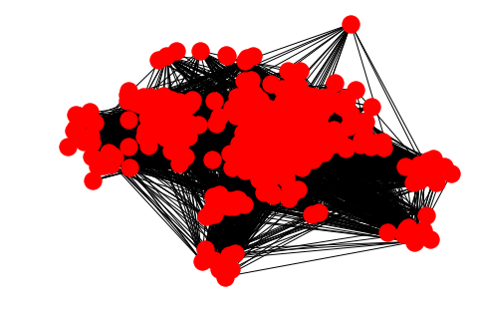
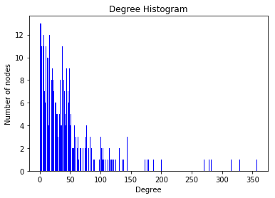
Implementation
Can see the clusters, but doesn’t quite look like Facebook
Scale free degree distribution
High clustering coefficient, varied using φ and δ
N = 500, k = 50, φ = 2, χ = 50, δ = 7

Slide 15
Problems
Limit to how far nodes can be from base
Edges are connected all over graph, unlike Facebook, where edges are mostly only within clusters
Transitivity is much lower, often about half of average clustering coefficient
This suggests that clustering of higher degree nodes is much smaller than lower degree nodes
Hubs are too widely connected to other clusters

